Slide 1


App Lab Step 2
Welcome back
Markup, Programs, Variables and Files

Slide 2

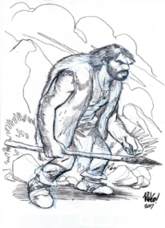


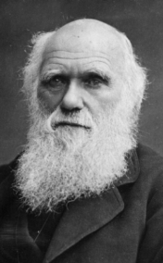


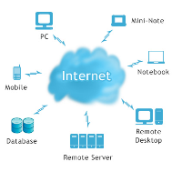


A warm welcome back
What did we do last week:
Rules (4 of them)
Evolution
What is an app?
Map of the internet – simple really – a few computes connected together.
The cloud and Amazon
Launched our server: 54.76.117.119
Question: Amazon Web Services have computers at various locations around the world. If you were building a web app for people in England which AWS site would you choose and why? Hint: try googling “AWS Locations”.

Slide 3
Markup vs Program
What's the difference?
HTML is mark-up – you can see it on our server 54.76.117.119
<!DOCTYPE html PUBLIC "-//IETF//DTD HTML 2.0//EN">
<HTML>
<HEAD>
<TITLE>
A Small Hello
</TITLE>
</HEAD>
<BODY>
<H1>Hi</H1>
<P>This is very minimal "hello world" web page sometimes called an HTML document.</P>
</BODY>
</HTML>

Slide 4
PHP is an example of a programming language
What's the difference?
<?php
echo "Hello World";
?>
<?php
echo "Hello World";
echo "<BR>";
echo 1+1;
?>
54.76.117.119/prog2_1.php

Slide 5
Lets Code

Slide 6
Some homework
Why is it good practice to create log files
What is a database?
What is it for?
Why do we need them?
What sort of information might one store?

Slide 7
Backup

Slide 8
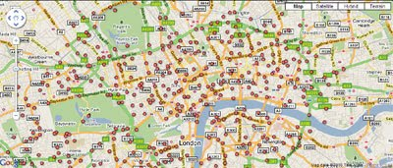
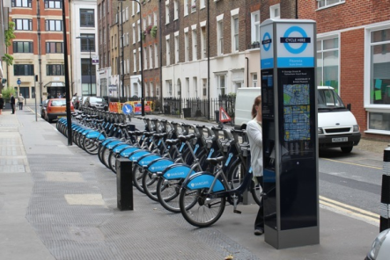
Our App
Build an App that lets a user dial a phone number from anywhere in the world, enter a location and hear a voice that tells them how many bikes there are at the specified Boris Bikes docking station.
Dial Number from phone
Hear greeting
Lookup bike info
Enter location
Read back number of bikes
Say goodbye

Slide 9
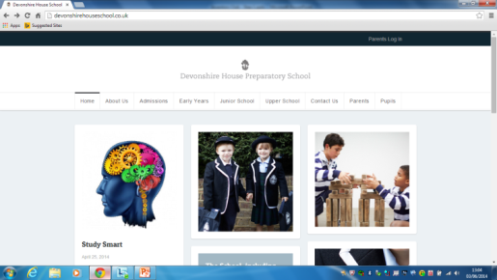
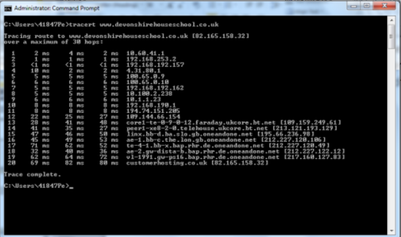
IP address
Devonshire House Preparatory School
2 Arkwright Road,
Hampstead,
London,
NW3 6AE
United Kindom
http://devonshirehouseschool.co.uk 82.165.158.32
ping devonshirehouseschool.co.uk 82.165.158.32

Slide 10
Quote
“Ah, but a man's reach should exceed his grasp,
Or what's a heaven for?”
Robert Browning
Reach for the stars.
A man, or woman, should try to do bigger and better things than they think they can can.
Go into the unknown regardless of fear.
Strive to go further.

